Slide 1
SEIS-785 IOT – Music Practice
George Sanchez

Slide 2
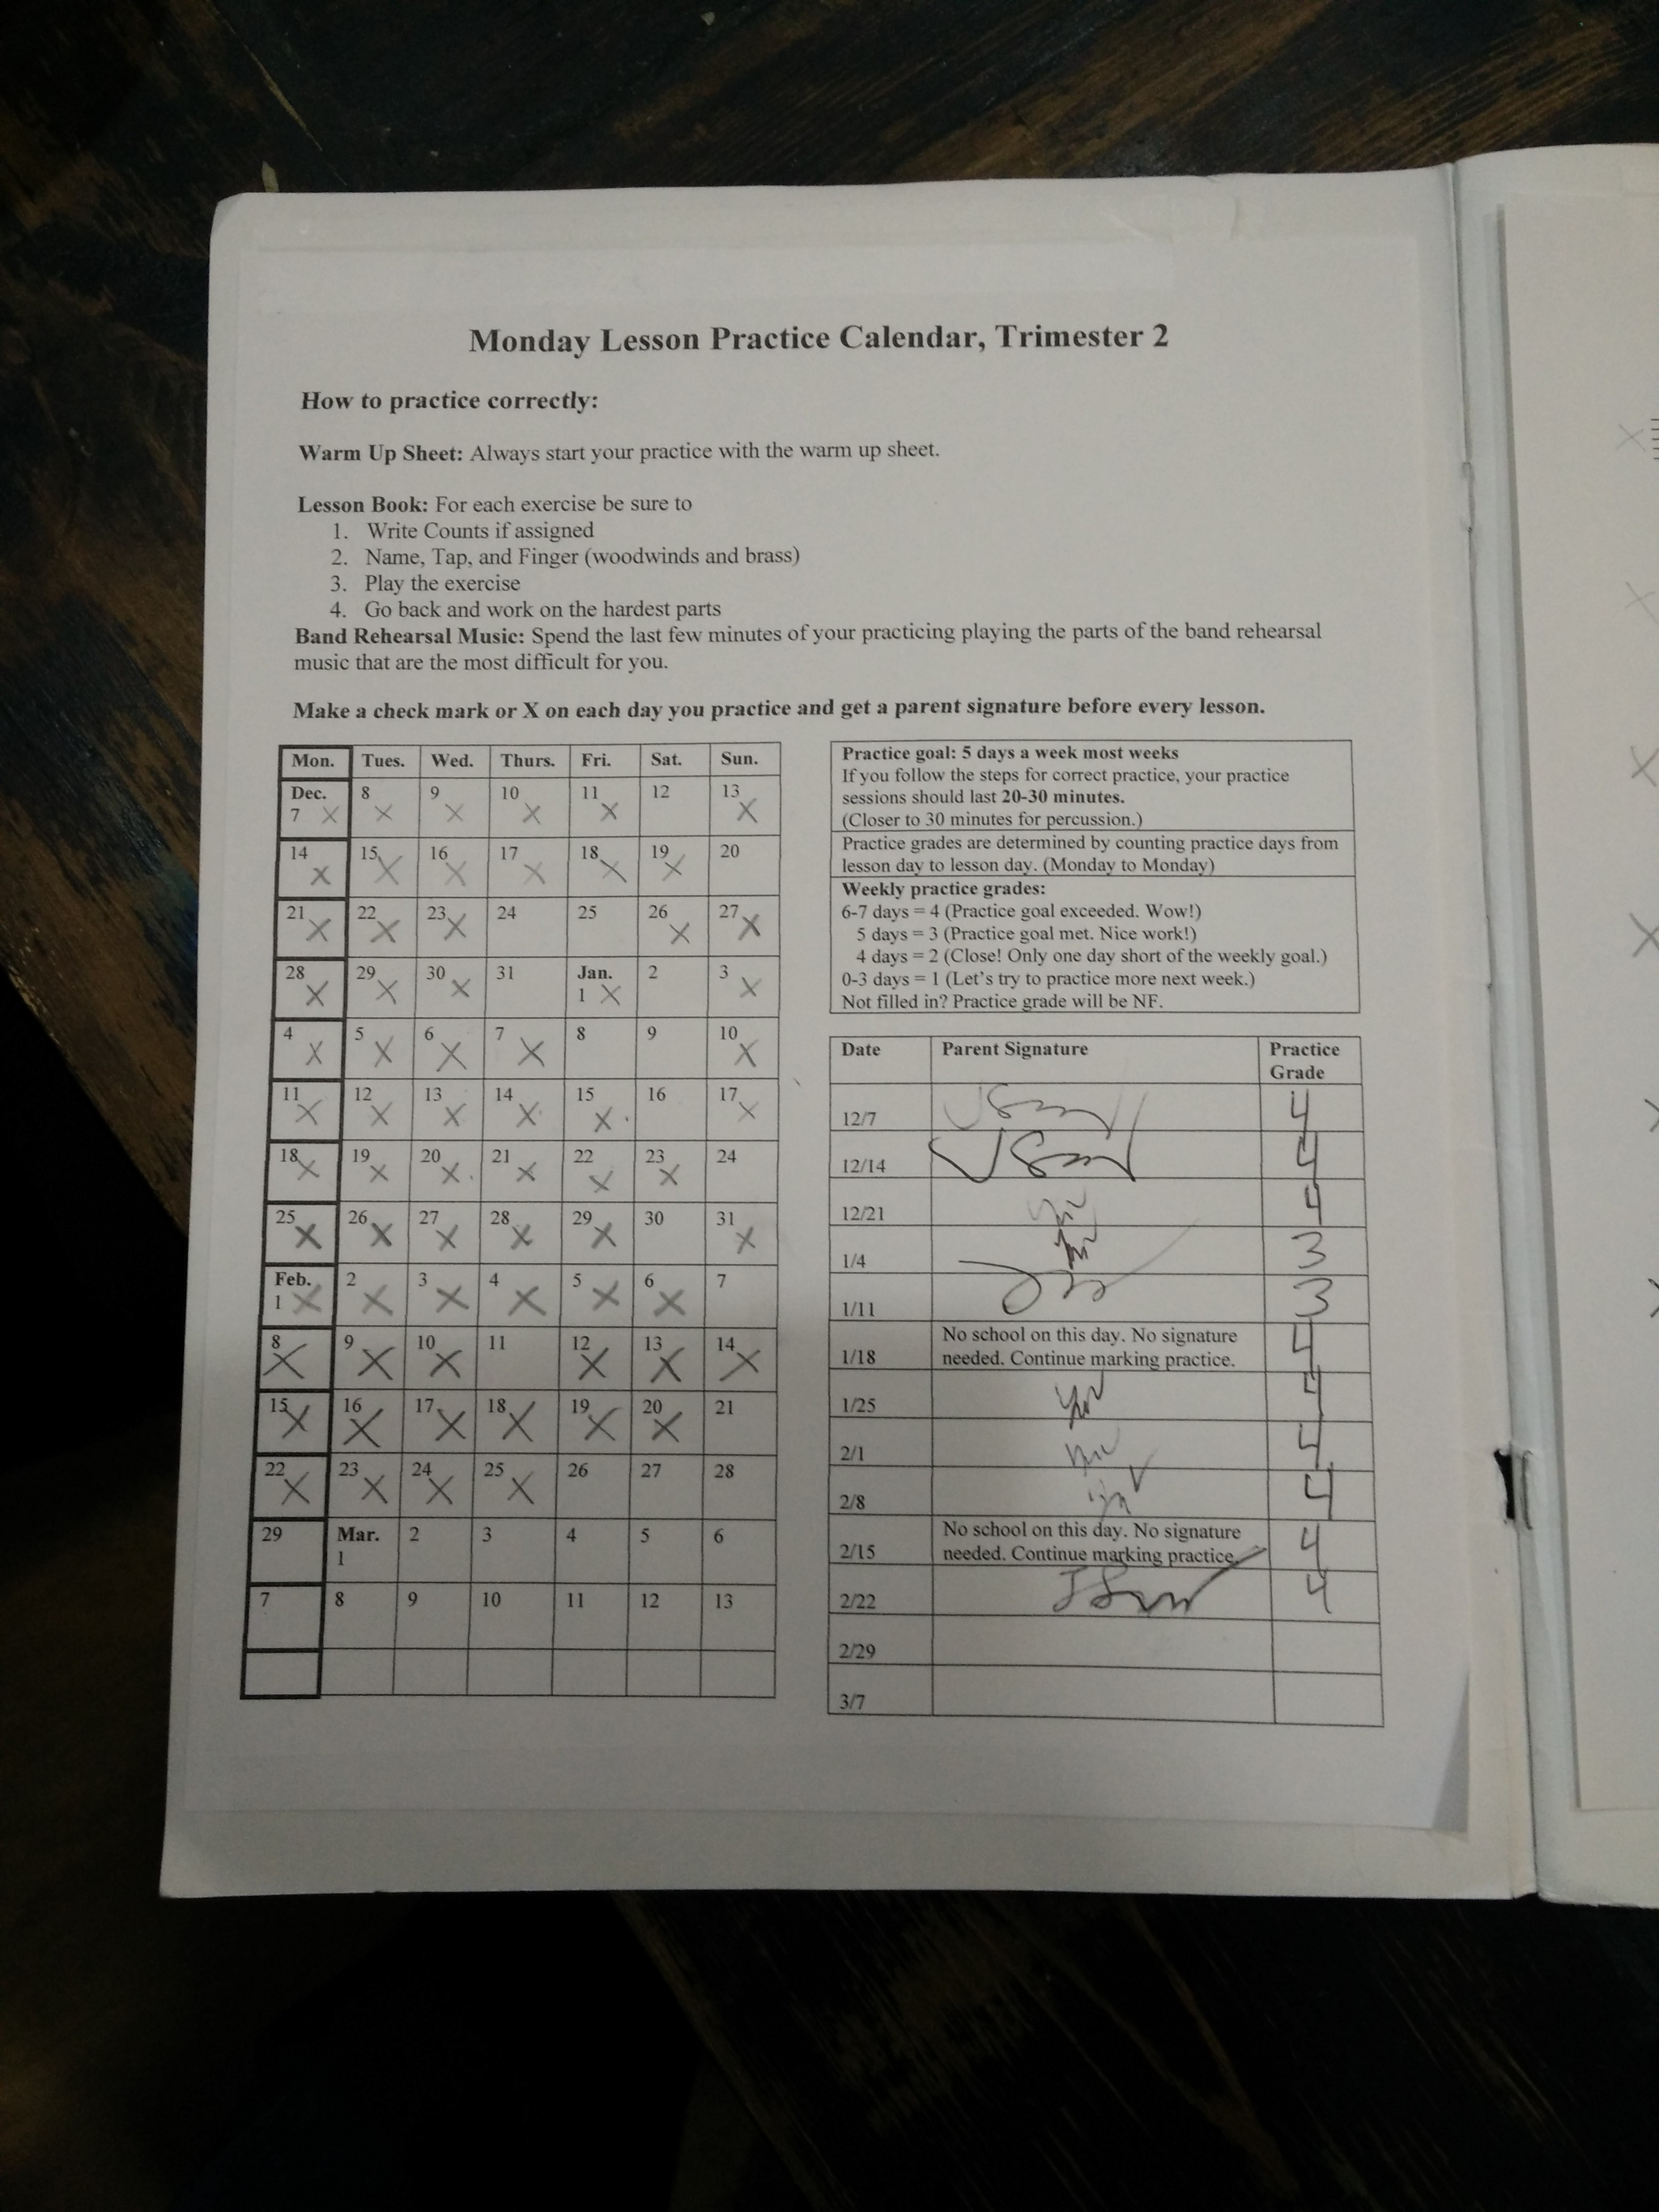
Why ?
Music education for my daughter involves multiple instruments piano, marimba, percussion
Needs to log a certain amount of practice everyday
Log book – needs to be signed by parent
Sometimes I sign not really knowing if she practiced or not
There must be a better way to track music practice

Slide 3
How ?
Create an Internet of things device that will log and monitor music practice
Use a microphone sensor to log sound coming from instrument and create a telemetry log of how long it has been playing
Must recognize sound signature for each instrument
(Maybe even compare the sound captured to actual music sheet data – need to digitize music sheet to have a comparison)
Calm Technology – gives feedback using led light to indicate status of practice
Gives feedback while playing – chose blue led lights to indicate that the sound is being logged
Elasticsearch – used elasticsearch because of potentially huge number of events that will be logged. Need the search capability to act or aggregate key events for all the logged events. This can be done efficiently thru a query in elasticsearch.

Slide 4
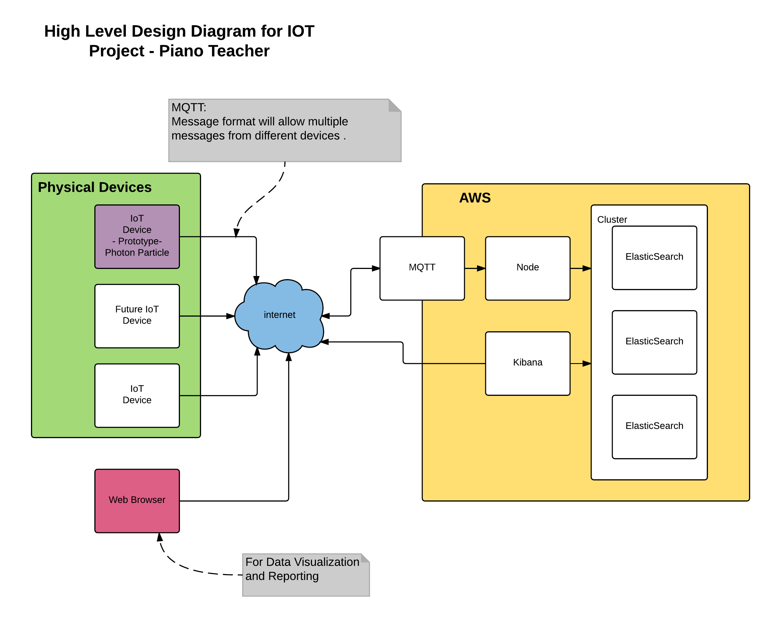
High level Architecture

Slide 5
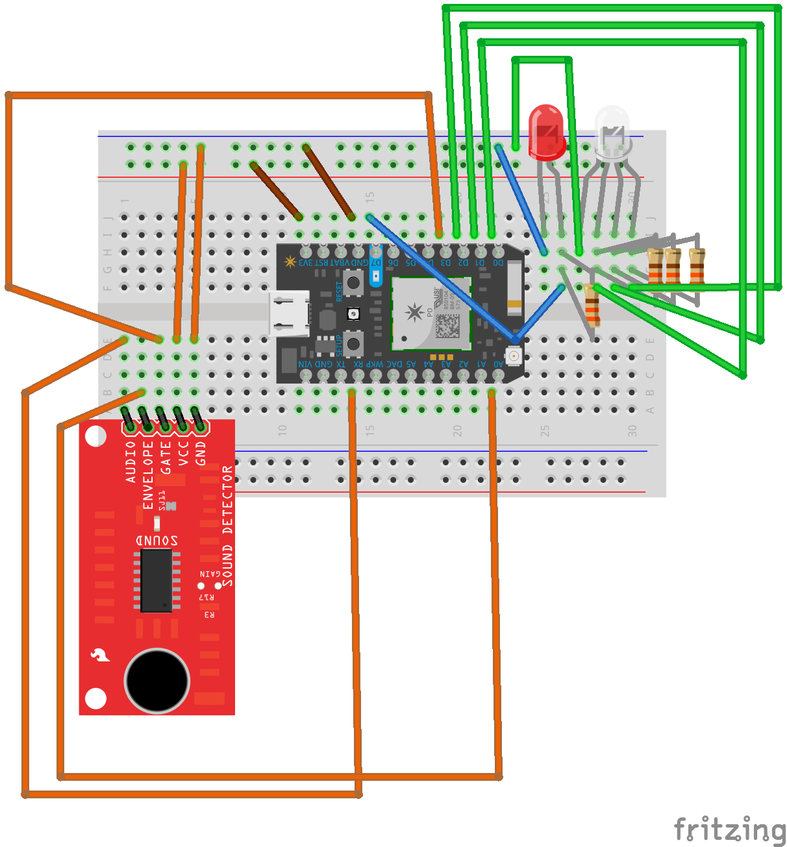
Fritz Image for Project

Slide 6
Technical Difficulties
Isolating piano sound versus human voice sound – since the human voice is within the pianos range.
Used pulseIn duration as well – difficult to calculate the actual practice time based on pulseIn duration
Have to interpolate between when the message is posted and the total pulseIn duration logged
Can’t tell if somebody can game the device
QOS 2 using open source MQTT Library – need a publish release

Slide 7
Future Plans
Find a way to recognize the instruments sound signature
How to compare sound log to a music piece
Add device to electronic metronome – or add metronome functionality

Slide 8
Demo
https://www.youtube.com/watch?v=hyLx62t5s3I

